Slide 1
Dynamic Music Generation with Deep Learning
Presentation By,
Silesh Chandran
Thomas Jose Alappat
Priyath Saji
Sandeep Gupta

Slide 2
Introduction
Creating music is considered as a creative task.
Getting a machine to do recreate this process is vital step in moving towards complete AI
Representing creativity and intuition in a machine is like to overcoming a great obstacle

Slide 3
Our project – An Overview
Our project is divided to 3 major phases:
Preprocessing phase
Training phase
Generation phase

Slide 4
Dataset consisting of MIDI file
Preprocessing
Note State Matrix
Training Phase
Trained Auto Encoder
Generating Phase
Generated Music (MIDI)

Slide 5
MIDI-Musical Instrument Digital Interface
MIDI is a communication protocol that allows a wide verity of instruments, computers and related devices to connect an communicate with each other.
MIDI files are small in size and can be processed faster with less overhead.
It consist of 8 bit words and 16 channels.
MIDI message is an instruction that controls certain output aspect.
One status byte followed by 2 data bytes.

Slide 6
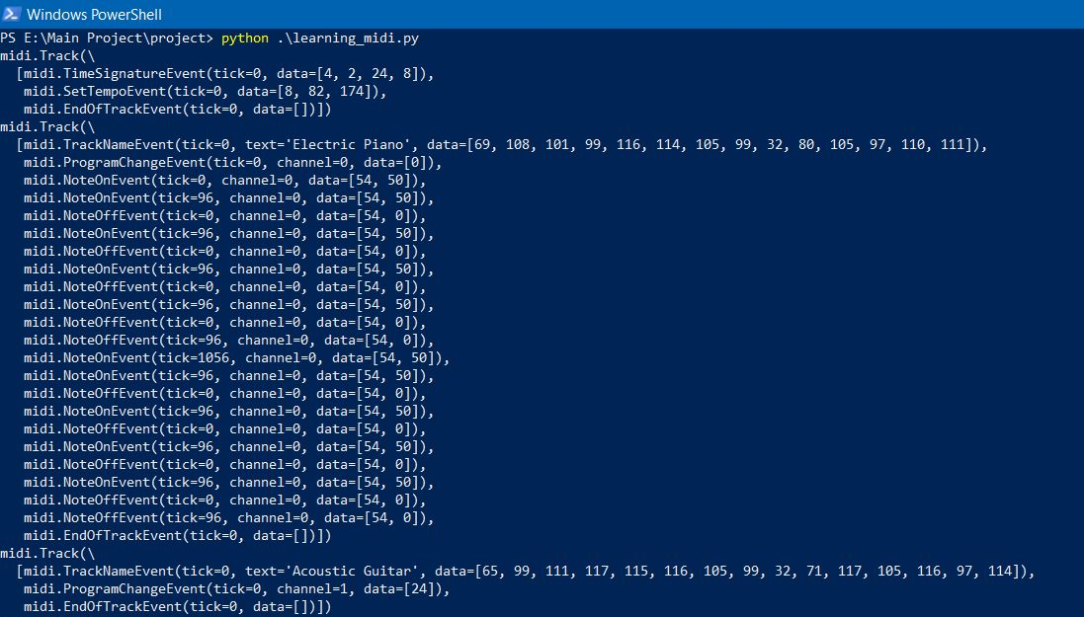
Processing with python-midi module

Slide 7
RBM-Restricted Boltzmann Machine
It is a generative stochastic artificial neural network that can learn a probability distribution over its set of input
As their name implies, RBMs are a variant of Boltzmann machines, with the restriction that their neurons must form a bipartite graph: a pair of nodes from each of the two groups of units (commonly referred to as the "visible" and "hidden" units respectively) may have a symmetric connection between them; and there are no connections between nodes within a group. By contrast, "unrestricted" Boltzmann machines may have connections between hidden units. This restriction allows for more efficient training algorithms than are available for the general class of Boltzmann machines, in particular the gradient-based contrastive divergence algorithm.

Slide 8
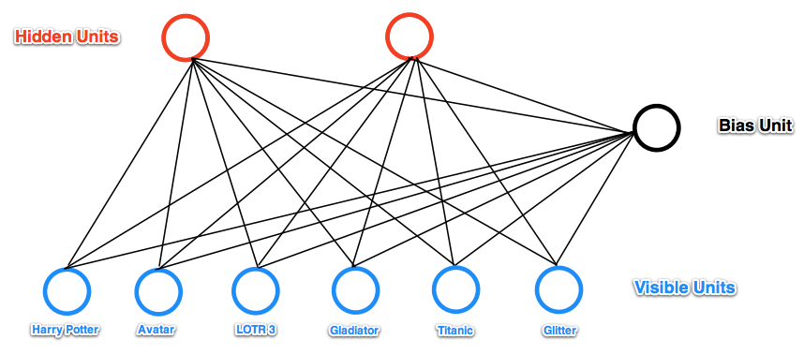

Slide 9
Restricted Boltzmann machines can also be used in deep learning networks. In particular, deep belief networks can be formed by "stacking" RBMs and optionally fine-tuning the resulting deep network with gradient descent and backpropagation.
RBMs have found applications in dimensionality reduction, classification, collaborative filtering, feature learning and topic modelling. They can be trained in either supervised or unsupervised ways, depending on the task.

Slide 10
Implementation road map
Stage 1: Monophonic midi files using AutoEncoder
Stage 2: Monophonic midi files using Recurrent Neural Networks
Stage 3: Polyphonic midi files using a combination of the two

Slide 11
AutoEncoder
An autoencoder, auto associator or Diabolo network is an artificial neural network used for unsupervised learning of efficient coding.
The aim of an autoencoder is to learn a representation (encoding) for a set of data, typically for the purpose of dimensionality reduction.
The autoencoder concept has become more widely used for learning generative models of data.

Slide 12
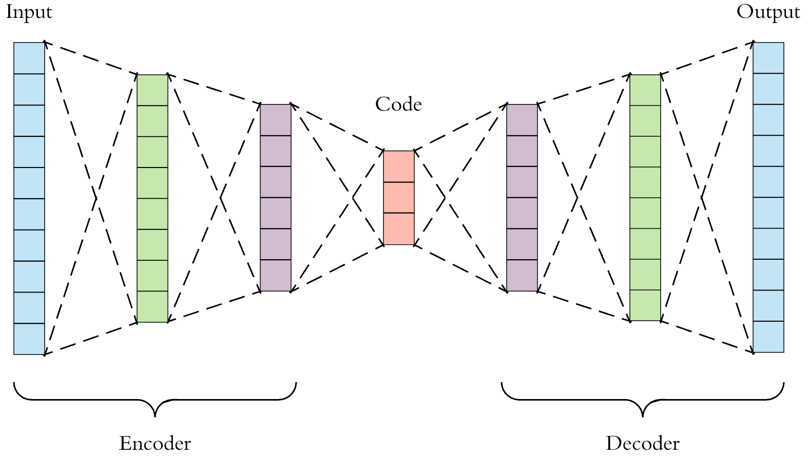

Slide 13
Recurrent Neural Networks
A recursive neural network is created by applying the same set of weights recursively over a differentiable graph-like structure by traversing the structure in topological order.
Such networks are typically also trained by the reverse mode of automatic differentiation. They can process distributed representations of structure, such as logical terms.
This essentially means that the neural network changes in order to adapt to the input and this change is carried over to the next stage.
This is accomplished using Long Short-Term Memory (LSTM) cells, which makes use of weighted gates to decide what information to remember and what to forget.

Slide 14
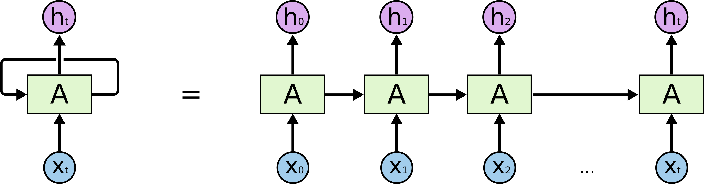

Slide 15
THANK YOU

